Slide 1

Rhode Island Property Insurance
Elizabeth Dwyer
Director, Department of Business Regulation

Slide 2
Availability and Affordability
Availability
20 licensed insurance groups writing greater than 1% of the Rhode Island market (92%)
FAIR Plan (4%)
Affordability
Rates have been increasing but not at the same pace as some other states
Surplus lines insurers (4%)
Notes:
Licensed – benefit of DBR review of rates and guaranty association in case of insolvency
Surplus – May have more beneficial coverage than licensed and FAIR Plan but no rate regulation or guaranty association protection
FAIR Plan – residual market created by legislature means that can always buy insurance
Percentages are very rough estimates just to give you a general understanding

Slide 3
Market Share for licensed insurers
Notes:
In addition to these 20 groups there are another 30 groups writing homeowners insurance in RI that have less than 1% of the market.

Slide 4

Average Premium
Rough estimate average annual homeowner premium in Rhode Island for 2024 about $2,400
Vary greatly by many variables
  Policy limits (amount available to rebuild home)
  Other coverages (liability)
  Deductibles
  Condition of property
  Prior losses
  Type of Coverage - Replacement Costs vs. Actual Cash Value
Notes:
This is a very difficult area because “average” depends on so many factor, cost to rebuild home, condition of property, location of risk but wanted to give a general comparative number to other issues within the housing conversation

Slide 5
Average Rate Increases of Licensed Insurers
Notes:
Average 8.91% a year

Slide 6
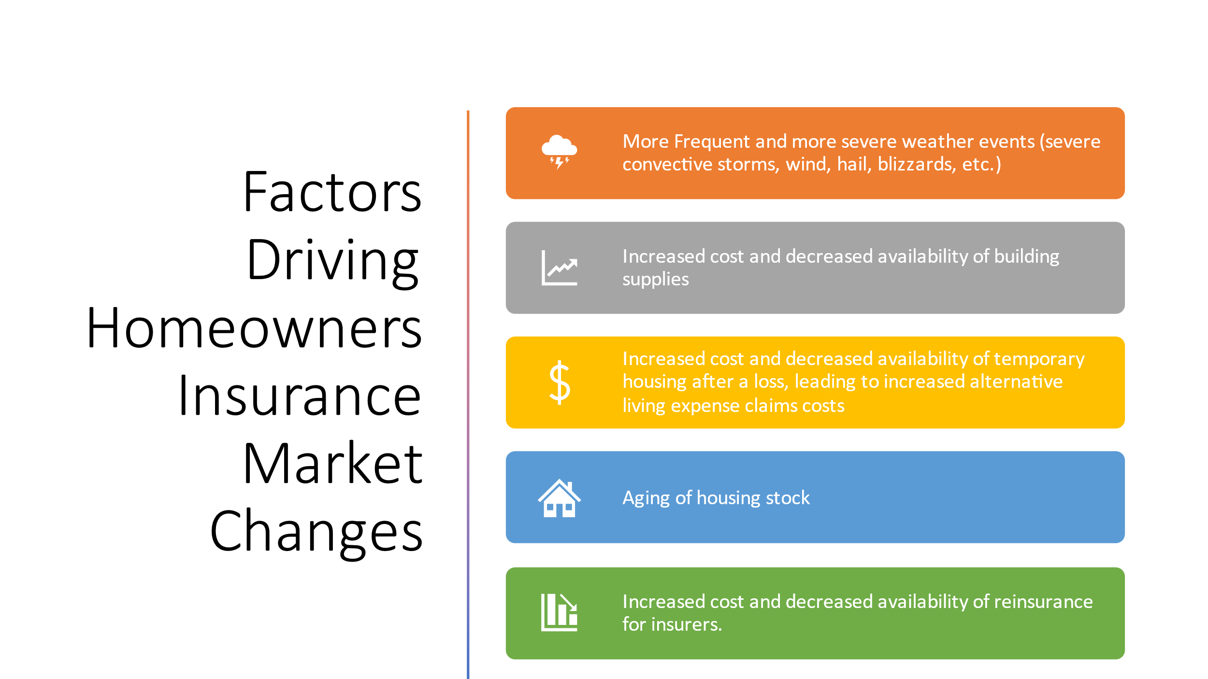

Slide 7
DBR Review
All rates charged by licensed insurers must be filed and approved by DBR
Rate filings are calculated by making projections on the overall losses that will be paid out
Large rate increases (over 25%) we may require the insurer to implement over a number of years
Profit margin not allowed higher than 10%
If insurer projection is wrong it cannot recoup prior losses in future rates

Slide 8
Exclusions and Coverage Gaps
Very important to read your policy when you receive it, not after a loss occurs
Flood is excluded from every licensed insurer’s property policy
Lender might tell you that you do not “need” flood insurance – what they mean is that you are not in a flood plane, so you are not required to buy it by federal law
If you do not buy a separate flood policy you will not be covered by insurance in the event of a flood
Other types of exclusions
Cosmetic only exclusion
Actual Cash Value for older roofs

Slide 9
Deductibles and Exclusions
May have one deductible for most losses and a percentage deductible for hurricanes
RI law allows up to 5% deductible only if a hurricane is established to have occurred in Rhode Island
RI does not allow insurers to impose wind or wildfire exclusions on property insurance
Notes:
5% deductible is applied to Coverage a so if home is insured for $500,000 the deductible would be $25,000

Slide 10
FAIR Plan
Although more risks are in the FAIR Plan, it still only amounts to 4% of polices in the homeowners market
The last three months of 2025 showed a decrease in policy counts and applications
Increased commercial quotes that do not go to FAIR Plan – possibly indicating that potential FAIR Plan customers are finding coverage in the voluntary market
Average premium higher than in the voluntary market
Notes:
Much too early to determine if the three months of decreases in FAIR Plan is an actual trend.

Slide 11
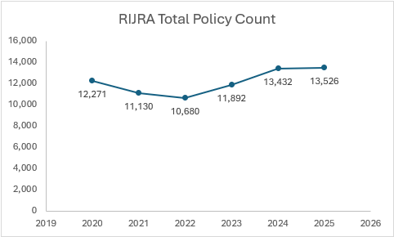
FAIR Plan policy count
Notes:
DBR has a representative at all FAIR Plan meetings and we monitor what the plan is doing.

Slide 12
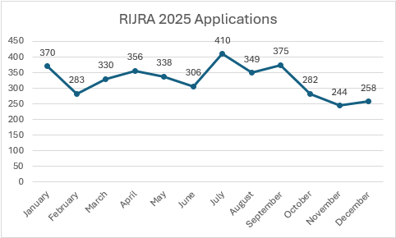
FAIR Plan application count

Slide 13
Consumer Strategies
Shop around
Insurers may offer different rates because they are attempting to create a book of business that will return the results that they project
Insurers might accept or reject individual risks not because of something wrong with that risk but because they need to diversify their book of business
Understand Coverages under policies
Notes:
Note – very important to insure to value to rebuild home. If less than full rebuild cost they may be provisions in policy giving insured a penalty for being underinsured
It is the consumers responsibility to keep track and increase limits if needed – Some insurers will suggest higher limits but others will not

Slide 14
Future Possibilities
Insurers will continue to use data and AI to attempt to get the most accurate rate for risk
New data collection
Reward resiliency efforts – possible higher premium for owners that do not maintain properties
Notes:
DBR has issued a Bulletin on Insurers use of AI indicating that we expect a human in the loop and compliance with the existing law when AI is used by an insurer
DBR has issued a bulletin in use of drones in underwriting

Slide 15
Questions
Contact information
DBR.insurance@dbr.ri.gov
401.462.9520

